Slide 1


Control Flow Structures - Loop Structures - Part A: Solutions
Where do I find MATLAB? Here!
Do I have to have MATLAB installed on my computer right now? No, you can use MATLAB Online!

Slide 2

Table of Contents
What we covered last week
Introduction
Loop Structures
For Loops
While Loops
Vectorized Approach
Part A Summary
MATLAB Live Script

Slide 3
What we covered last week
This week in part 2, we learnt about:
What arrays and matrices are
Creating arrays
Indexing into arrays
Concatenation of arrays
Operating with function on arrays

Slide 4
Introduction
In programming, a control flow is the order in which individual statements, instructions or function calls of a piece of code are executed or evaluated. An integral part of programming beings with understanding how to automate the process of running/executing an algorithm. This lesson will be split into two parts: part a and part b. In part a we go over the fundamental loop structures in MATLAB and how to use them, we will also touch on vectorisation as a way to create computationally efficient code.

Slide 5
Loop Structures
Loops are control instructions that are commonly used for iteration and repetition. For example, given a list of names such as ["John", "Freddy", "Lisa"], you may want to print out each of the names in the list so that they appear on the MATLAB command window. This could be manually achieved by using a built-in function in MATLAB called disp() to display all 3 names on the MATLAB command window.
disp("John")
disp("Freddy")
disp("Lisa")
Considering that the list only has 3 names, this is easily achievable. However, consider a case where our list has 10 names, whilst you may still be able to get away with manually displaying all 10 names, it is easy to see how tedious this process can be as our list gets bigger. Loop control instructions can be used to automate the process of iteratively calling all names sequentially in a given list without the need for manually calling each name individually from the list. There are 2 main loop controls that are supported in MATLAB, namely for loops and while loops.

Slide 6
For Loops
For loops are used for iterating over a sequence such as an array, a set or a string. For loops are used in instances where an algorithm needs to be repeated for a specified number of times, and only stopping once the ideal number of iterations has been reached. The common structure if a for loop is specified as follows:
for i = v
Loop body
end
All For loop statements begin with the keyword "for”, followed by what is called an iteration variable (in this example, i) which represents each of our list items at a single time. This variable is set equal to our list (v) which in this example contains a list of names. The loop body contains the instruction that will be repeated for all elements in the list. Finally, the loop is closed by using the keyword "end". It should be noted that for loops in MATLAB require the "end" declaration at the end of the loop body to complete the structure of a for loop.

Slide 7

For Loops
The standard process begins at the iteration variable where an element from the list is taken into the loop body where a set of instructions are executed on the variable, this process happens iteratively for all elements in the list. In our names example this would look like this,
In this example we will create an array with 3 names, refer to week 2 to learn more about how to create different arrays. Using square brackets [] will give an array whilst {} brackets will give a cell array. All elements in array related brackets [] must be of the same data type and elements in a cell array {} can have different data types.
for i = ["John", "Freddy", "Lisa"]
disp(i)
end
For loops can be used with different data structures. For example, a for loop can be used to sum numbers in an array.
sum = 0;
for i = 1:10
sum = sum + i
end

Slide 8

For Loops
Now Try for Yourself!
In the line below, using a for loop statement, find the sum of the array "numbers" and assign it to the variable "counter".
numbers = [2, 4, 6];
counter = 0;
for i = numbers
counter = counter + i;
end
disp(counter)
12

Slide 9
While Loops
While loops are another kind of loop structure. Whilst for loops can be used unconditionally (without a condition), while loops can be iterated based on a specified condition. For example, given a list of numbers, you may want to sum the first 10 numbers on the list with summing all elements in the list. The common structure of a while loop is specified as follows:
while (condition)
Loop body
end
The keyword for starting a while loop is "while" followed by a condition which will terminate the loop but otherwise continue unless the condition has been met. This is followed by the loop body where a set of instructions are executed and just like the for loop, an "end" keyword is used to close the while loop.

Slide 10
While Loops
An example is given as follows,
sum = 0;
while sum <= 10
sum = sum + 1
end
In the for loop example, an iteration variable "i" was used based on the elements of a list, however, in the above example, the while loop uses an independent variable that is initialised to 0. The condition in the while loop states that if the independent variable is less than 10, the variable will be incremented by 1. This while loop terminates once the independent variable goes over 10.
The idea of using a loop structure can be greatly appreciated in numerical computations where usually the same piece of code is repeatedly executed. In real world applications, the error of repeatedly executing a piece of code can be reduced by using a loop structure. Loops can be nested in MATLAB. The for loops can be nested within while loops, and vice versa. To finish a loop, there should be a matching end statement.

Slide 11
While Loops
Now Try for Yourself!
In the line below, using a while loop statement, individually display the apples element in the "fruits" array.
fruits = ["apricot", "pears", "pineapples", "apples"];
for i = fruits
disp(i)
end
disp(counter)
apricot
pears
pineapples
apples

Slide 12
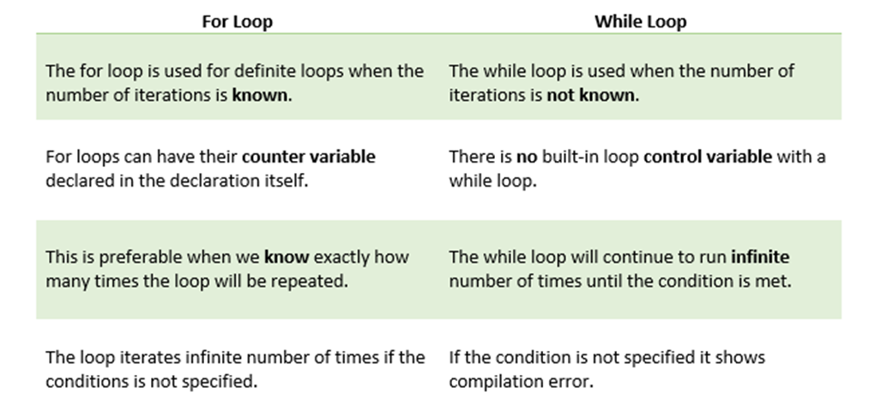
While Loops
Some notable differences between for loops and while loops are given in the table below,

Slide 13
Vectorized Approach
So far the given examples of the different loop structures have been reasonably simple, however, loops can often be used to build complex algorithms that can result in the overall execution of the algorithm slowing down. Using a vectorized approach can sometimes assist with the computational speed of an algorithm by considering a matrix or a vector as a whole object thus removing the need for loops. This increases the efficiency of a piece of code.
r = [1, 1.2, 0.9, 0.7, 0.85, 0.9, 1.12, 0.56, 0.98]
for counter = 1:1:length(r)
circleArea(i) = pi*r(i)^2;
end
circleAreas
however, using the vectorisation method we can directly compute each circle area from the corresponding radius in the array using dot notation (.) represented in the pseudo-code;
r = [1, 1.2, 0.9, 0.7, 0.85, 0.9, 1.12, 0.56, 0.98]
circleAreas = pi*r.*^2;

Slide 14

Vectorized Approach
Now Try for Yourself!
Given the side lengths of various squares, use vectorisation to calculate the area of the various squares $\left(a^{2}\right).$ Fill in the notation in the space below.
a = [3, 6, 9];
areaSquare = a .^2
areaSquare = 1×3
9 36 81

Slide 15
Vectorized Approach
In the example below, a concept called pre-allocation is used. For and While loops that incrementally increase the size of a data structure each time through the loop can adversely affect performance and memory use. Repeatedly resizing arrays often requires MATLAB to spend extra time looking for larger contiguous blocks of memory, and then moving the array into those blocks. Often, you can improve code execution time by pre-allocating the maximum amount of space required for the array.
tic
cubeSurfaceArea = zeros(1, length(a)); % Pre-allocation
for i = 1:length(a)
cubeSurfaceArea(i) = 6*a(i)^2;
end
cubeSurfaceArea
toc

Slide 16
Vectorized Approach
However, using vectorisation is a much more preferred way. It eliminates the need for pre-allocation and speeds up the execution time of a piece of code.
tic
cubeSurfaceArea = 6*a.^2;
toc
As can be seen by the time taken to execute both examples, the vectorised method is time efficient compared to the for-loop structure.

Slide 17
Part A Summary
Loop structures can be used to automate the process of repeating an instruction.
There are two kinds of loop structures: For loops and While loops.
For loops can be used when the number of iterations is known and While loops can be used when the number of iterations is not known.
Vectorization can be used to replace loops where each element in an object (i.e array) is treated as a whole object.

Slide 18
MATLAB Live Script
Click on the link below for this lecture’s MATLAB live Script
Week_3_Part_1_Control_Flow_Structures.mlx
Copyright 2022 The MathWorks, Inc. & Opti-Num Solutions (Pty) Ltd.

